Slide 1
Hypertension – otologic symptoms
Ivana Aras, MD, pD, ENT, audiologist,
Suvag polyclinic zagreb

Slide 2
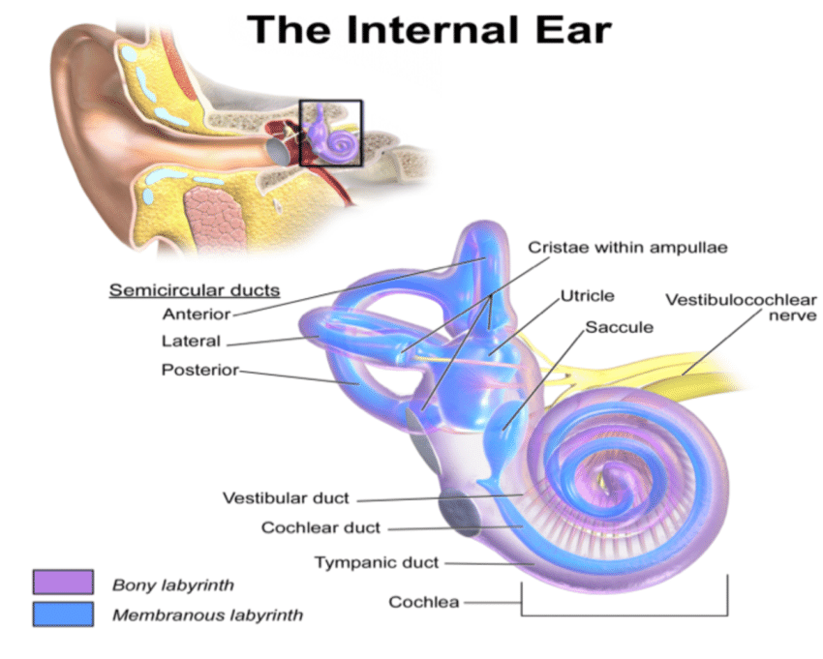
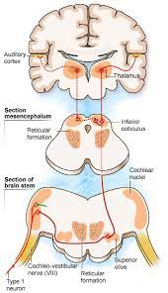
internal ear symptoms
Hearing impairment
Tinnitus
Balance problems

Slide 3
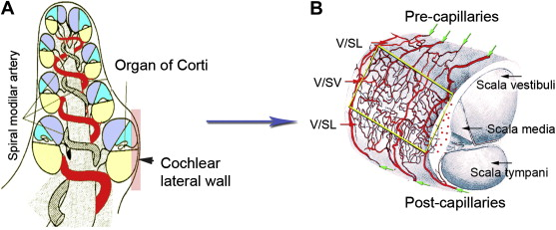
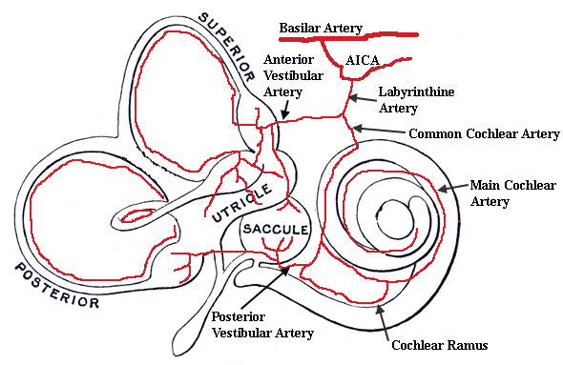
HEARING IMPAIRMENT
Possible mechanisms of damage (HBP):
1. increased viscosity – resistance – oxygen deprivation
2. hemorrhage within the cochlea
3. constriction of labyrinthine art. due to atherosclerosis
4. AGING

Slide 4
Hearing impairment
debate on the association between hypertension and hearing loss
37 – 43% hearing loss amongst hypertensives (India, Africa)
Studies from Brasil and USA reported comparable hearing tresholds between two groups
OTHER IMPORTANT ETHIOLOGY FACTORS, COMORBIDITY, SINERGY COMPLIANCE

Slide 5

Antihypertensive therapy
’70 – furosemide ototoxicity?
SSNHL - reversible
Recent studies did not find that association

Slide 6
Sudden Sensoryneural hearing loss
(sshl)
Older patients, longer hypertension : increased risk for thrombotic and haemorrhage events
Younger, healthy patients: Hypotension

Slide 7
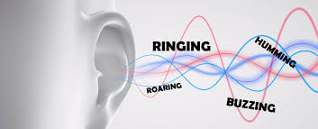
TINNITUS
With or without hearing loss
43% amongst hypertensive adults
Connected with grade 3 hypertension
Treatment with diuretics, ACE inhibitors, calcium channels blockers
more prevalent in tinnitus patients

Slide 8
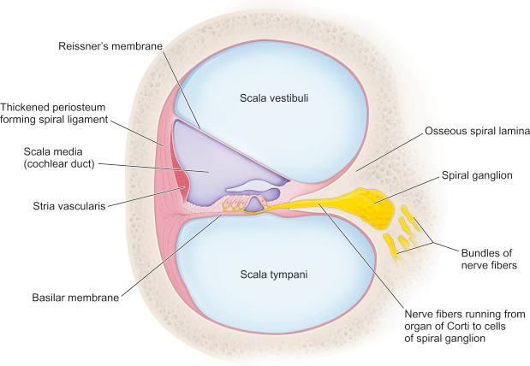
TINNITUS
Inner ear circulation – STRIA VASCULARIS damaged by art. hypertension
Sodium retention (increased extracellular perilymph volume, edema) resulting in reduced endocochlear potential

Slide 9

BALANCE PROBLEMS
DIZZINESS – illusion of movement
VERTIGO – illusion of rotation, usually vestibular pathology

Slide 10

Dizziness – blood pressure
Hypertension
Hypotension – orthostatic hypotension
MEDICATIONS
BARORECEPTORS – SYMPATHETIC RESPONSE
Extremely high blood pressure – VERTIGO, NAUSEA
Changes from high to low BP

Slide 11
PREVENTION
Hearing and balance problems significantly reduce persons functioning, important subject of public health.
Prevention is important as treatment is often long, difficult and expensive
Regulating BP – one of the factors to keep a good function

